Slide 1
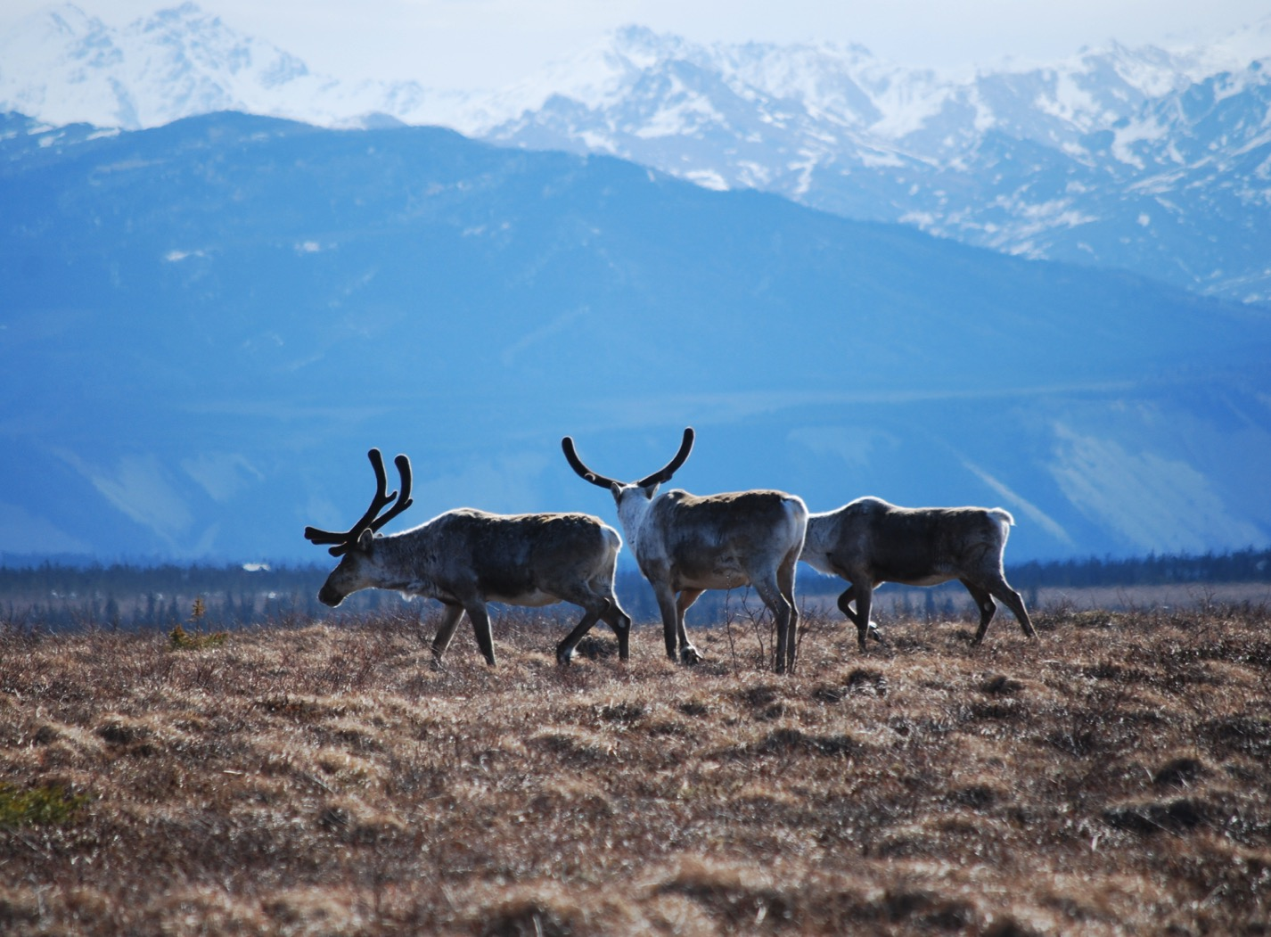
Arctic Boreal Vulnerability Experiment (ABoVE)
2017 ABoVE Airborne Campaign
15 June 2017 (DOY 166)
UAVSAR: Yellowknife – Fairbanks Transit
Charles Miller, Deputy Science Lead
Jet Propulsion Laboratory, California Institute of Technology
and the ABoVE Science Team For Hank Margolis, Eric Kasichke, Bruce Tagg
NASA HQ
2017

Slide 2
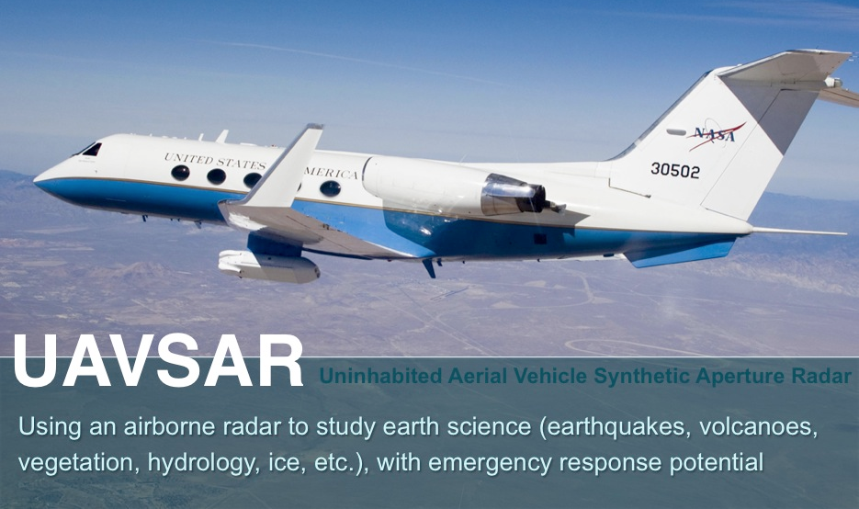
15 June 2017/DOY 166 Yellowknife – Fairbanks Transit
Daily Summary:
C-20A (N30502) UAVSAR ABoVE CAMPAIGN (CANADA / ALASKA)
REPORT DATE: 15 June 2017
Current Status of Aircraft: GREEN
Current Status of SAR: GREEN
Current Status of PPA: GREEN
Current Deployment Location: Fairbanks, Alaska (PAFA)
Crew: Asher, Barry, Meza, Griffith, Choi, T Miller, Moreno, Tan, McGrath
Science Coordinator: N Pinto
Science Lead: M Moghaddam
Project Manager: Y Lou

Slide 3
15 June 2017/DOY 166 Yellowknife – Fairbanks Transit
Daily Summary:
Transit + Science Flight – Yellowknife (CYZF) to Fairbanks (PAFA) – 4.2 hours
Great flight
Collected 10 of 10 data lines
Ft. Liard, Watson Lake, Wolf Creek, Kluane, Tok, Delta Junction
Flight Plan – 1043v02

Slide 4
15 June 2017/DOY 166 72-Hour Look Ahead
All plans weather dependent
Friday 16 June 2017 (DOY 167):
Southwest Alaska
Saturday 17 June 2017 (DOY 168):
Yukon-Kuskokwim Delta
Sunday 18 June 2017 (DOY 169):
Hard down day
Monday 19 June 2017 (DOY 170):
Seward Peninsula

Slide 5
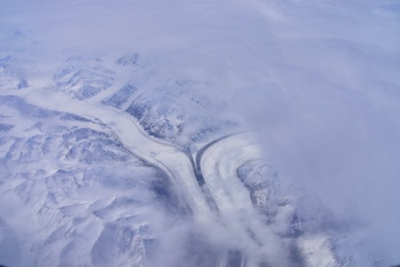
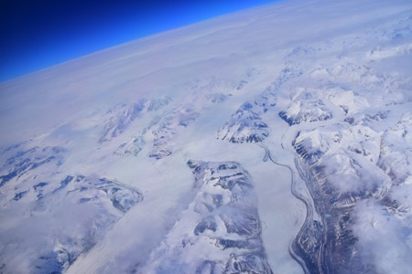
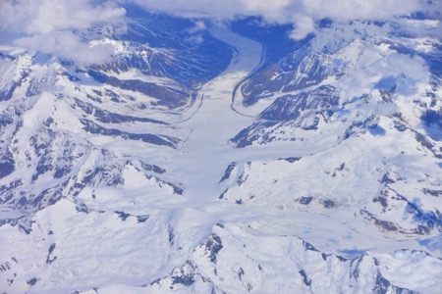
15 June 2017/DOY 166 Yellowknife – Fairbanks Transit
Stevens Village
Beaver
Glaciers in the Kluane Lake area of the Yukon Territory
Kotzebue
Notes:
https://www.youtube.com/watch?v=aPVLyB0Yc6I

Slide 6
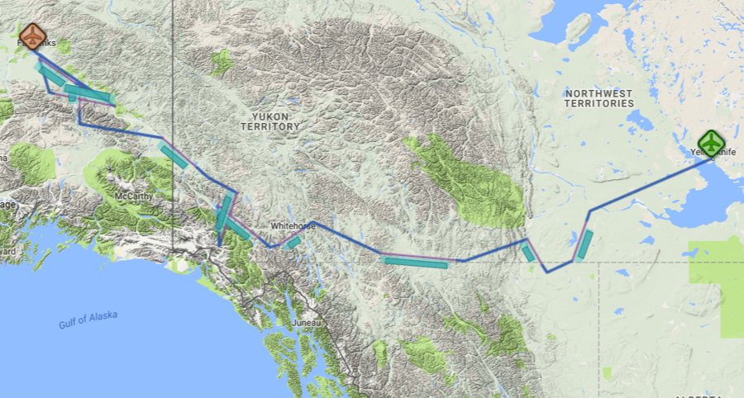
15 June 2017/DOY 166 Yellowknife – Fairbanks Transit
Flight Plan 1143 v02, Report 17064:
Yellowknife NT (CYZF) Fairbanks AK (PAFA) – PAFA
https://uavsar.jpl.nasa.gov/cgi-bin/report.pl?planID=PLAN_17064#flightPlan
6/15/17 flight plan & acquisition segments
Data Acquisitions:
Line 1, ID 20027: Scotty Creek
Line 2, ID 33021: Fort Liard
Line 3, ID 27510: Watson Lake
Line 4, ID 23602: Wolf Creek
Line 5, ID 30806: Kluane Lake 1
Line 6, ID 01902: Kluane Lake 2
Line 7, ID 31040: Tok
Line 8, ID 00101: Delta Junc 1
Line 9, ID 30407: Delta Junc 2
Line 10, ID 10204: Delta Junc 3
00101
30407
10204
31040
30806
01902
23602
20027
27510
33021
Notes:
\

Slide 7
15 June 2017/DOY 166 Yellowknife – Fairbanks Transit
UAVSAR Quick-look products
A. Line 1, ID 20027: Scotty Creek
B. Line 2, ID 33021: Fort Liard
C. Line 3, ID 27510: Watson Lake
Ian Tan, JPL
A
B
C
Notes:
Image of the Scotty Creek watershed, flux towers, and several of its 6 km x 6 km Airborne Observing Intensive (AOI) sites
The boreal forest around Fort Liard is the most productive of the long-term CFS measurement plots across the Northwest Territory
Sampling over long-term measurement sites in the Wolf Creek YT area

Slide 8
15 June 2017/DOY 166 Yellowknife – Fairbanks Transit
UAVSAR Quick-look products
A. Line 4, ID 23602: Wolf Creek
B. Line 5, ID 30806: Kluane Lake 1
C. Line 6, ID 01902: Kluane Lake 2
Ian Tan, JPL
A
B
C
Notes:
A. Sampling over the permafrost/active layer thickness measurements near Wolf Creek
Transect sampling along Kluane Lake
This line covers the Hyperion acquisition swath of Kluane Lake/Slims River

Slide 9
15 June 2017/DOY 166 Yellowknife – Fairbanks Transit
UAVSAR Quick-look products
A. Line 7, ID 31040: Tok
Ian Tan, JPL
A
This line crosses the Canada-Alaska border between Beaver Creek, BC and Northway, AK, capturing a long boreal forest transect
Notes:
A&B: these lines support multiple teams looking at the impact of the 2015 fires on tundra, carbon fluxes and wildlife. Ground penetrating radar measurements will be acquired over select ground sites here
C. UAVSAR imagery will help characterize coastal weltands and critical waterfowl areas of the YK Delta

Slide 10
15 June 2017/DOY 166 Yellowknife – Fairbanks Transit
UAVSAR Quick-look products
A. Line 8, ID 00101: Delta Junc 1
B. Line 9, ID 30407: Delta Junc 2
C. Line 10, ID 10204: Delta Junc 3
Ian Tan, JPL
A
B
C
Notes:
Multiple views of the Delta Junction area, including sampling of the NEON intensive observation box

Slide 11
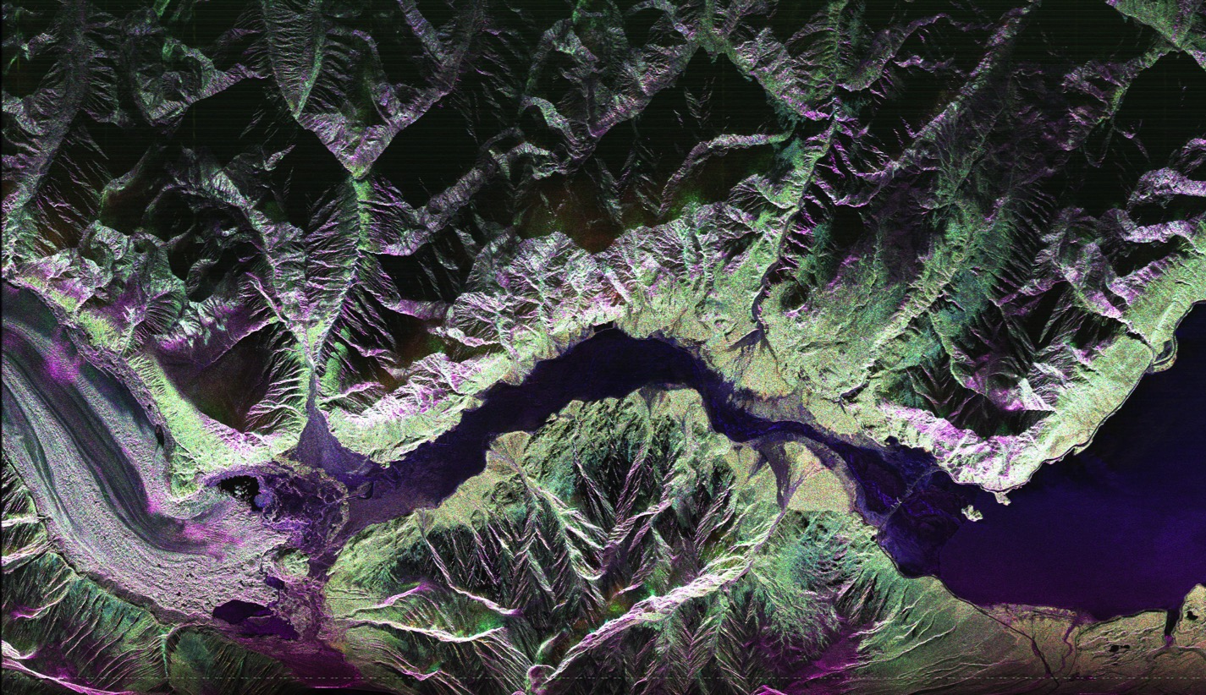
15 June 2017/DOY 166 Yellowknife – Fairbanks Transit
Kaskawulsh
Glacier
Slims R.
Kluane
Lake
Kaskawulsh
River
Notes:
UAVSAR image clearly shows water flowing from the the Kaskawulsh Glacier into the Slims River and Kluane Lake. “River Piracy” occurred abruptly in Spring 2016, when Kaskawulsh retreat triggered a shift in its melt began flowing into the Kaskawulsh River rather than the Slims River, leading to a drop of ~1 meter in Kluane Lake level. Shugar et al. [Nature Geoscience, April 2017] documented how retreat of Kaskawulsh Glacier—one of Canada’s largest glaciers—abruptly and radically altered the regional drainage pattern.

